Slide 1

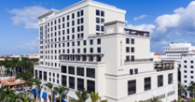
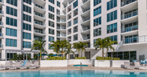

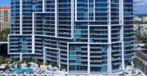


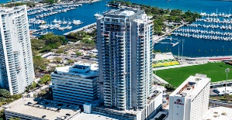
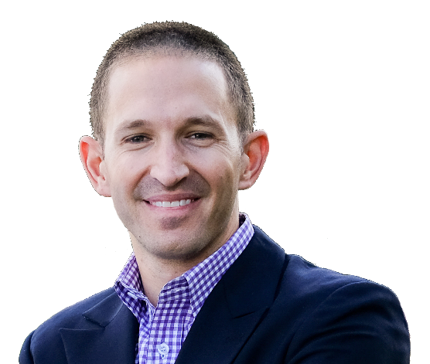
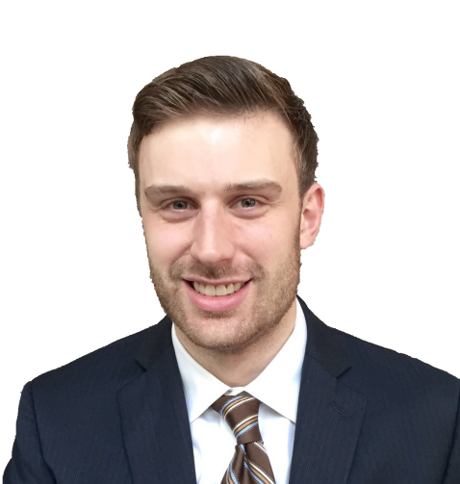
EB5AN is a USCIS-authorized regional center (RC) operator, EB-5 consulting firm, and global investment fund manager. EB5AN helps foreign investors obtain
U.S. permanent residency (Green Cards) through investments in U.S. projects
within the guidelines of the EB-5 Immigrant Investor Program.
EB5Investments.com • EB5AN.com
The EB-5 Immigrant Investor program allows a qualified foreign national, along with their spouse and any children under 21,
to obtain permanent Green Cards through an eligible investment that creates at least 10 new U.S. jobs per investor.
COMPANY OVERVIEW
Founding Year | 2013
EB-5 Regional Center Investment Funds | 21
Total Project Development Cost | $2.9B+
EB-5 Jobs Created | 19,000+
Project Success & Investment Compliance | 100%
CURRENT RC PROJECT INVESTMENT TERMS
Investment Amount | $800,000
Project Administrative Fee | Varies by Project
Annual Return | Varies by Project
Estimated immigration legal fees, USCIS filing fees and RC Integrity Fund fees | $30,000 – $40,000
SELECT SUCCESSFUL
RC PROJECTS (CLOSED)
Water Club North Palm Beach
USCIS I-526, I-924
Exemplar &
I-829 Approved
Hyatt Place Boca Raton
USCIS I-526, I-924
Exemplar &
I-829 Approved
PROJECT TRACK RECORD
I-924 and I-956F “Exemplar” Approval Rate | 100%
Project Completion/Development¹ and Investment Compliance | 100%
INVESTMENT APPROACH
EB5AN’s approach is to identify institutional-quality real estate development projects that satisfy its strict internal underwriting criteria for both immigration and financial risk. EB5AN managed projects are structured to not be reliant on any minimum amount of EB-5 funding to achieve completion. Additionally, EB5AN prioritizes investing in projects with EB-5 jobs already created for its investors, and those that are ultimately projected to create significantly more jobs per investor than are required under the EB-5 program. EB5AN collaborates with multiple top development firms including Kolter—one of the largest private developers in the country. Kolter has been involved in over $29 billion of real estate transactions since its founding in 1997 and has never failed to complete a project, and never failed to repay a loan². EB5AN is 100% independent from Kolter.
The Mark Sarasota
USCIS I-526 & I-924
Exemplar Approved
REGIONAL CENTER TRACK RECORD
I-956 Regional Center Designation Approval Rate | 100%
I-924A and I-956G Annual Compliance / Current Standing | 100%
Twin Lakes Georgia
(Fund XVI)
USCIS I-956F
Exemplar Approved
INVESTOR TRACK RECORD
EB5AN EB-5 Investors | ~1,000
I-526/E Approval Rate (RC and project) | 100%
I-526/E Denials¹ (source of funds only) | 5
Early Repayment for I-526/E Denial | 100%
I-829 Approval Rate | 100%
Investor Preferred Returns Paid and Funds in Good Standing or Repaid | 100%
VUE
Sarasota
USCIS I-526 & I-924
Exemplar Approved
Full Original Investment Successfully Repaid
EXECUTIVE TEAM
EB5AN was founded by its Managing Partners Samuel B. Silverman and Michael B. Schoenfeld The EB5AN executive team has extensive experience in business strategy, investment evaluation, and securities, tax, and immigration law. Before founding EB5AN, the management team advised Fortune 500 companies on growth and investment strategies and worked on some of the largest private equity buyouts and corporate strategy initiatives. The founders hold degrees from Yale, Stanford, and UNC Chapel Hill, and previously worked at some of the most prestigious investment and professional services firms including the Boston Consulting Group (BCG) and AEA Investors.
Twin Lakes Georgia
(Fund XIV)
USCIS I-526E & I-956F
Exemplar Approved
PORTFOLIO OVERVIEW | #
Total Projects (21 investment funds across 15 developments) | 15
Under Construction | 5
Construction Completed | 10
Wohali
Utah
USCIS I-526E & I-956F
Exemplar Approved
PROJECT LOCATION | #
Southeast (Florida/Georgia) | 12
Colorado | 2
Utah | 1
Saltaire
St. Petersburg (Fund X)
USCIS I-526 & I-924
Exemplar Approved
Full Original Investment Successfully Repaid
“At EB5AN, we believe you deserve the best information, the best service, and the best projects. Since our founding, we have delivered on our promises to EB-5 investors by funding institutional-quality real estate development and operating projects that not only meet the immigration requirements of the EB-5 program but also provide a level of transparency and financial security that remains unmatched in the EB-5 industry.”
Samuel B. Silverman
Founder and Managing Partner
Michael B. Schoenfeld
Founder and Managing Partner
All statistics and figures referenced herein are as of April 2024.
¹ Very few of EB5AN’s investors were not approved due to source of funds issues and were refunded their investment amount under the applicable project’s I-526 approval refund guaranty.
² All of EB5AN RC investments are either closed and repaid in full, or remain completely or partially outstanding and in compliance with all investment covenants.

