Slide 1
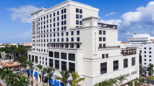
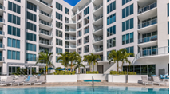
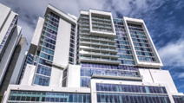
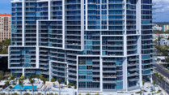
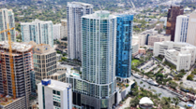
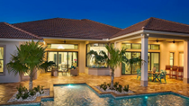
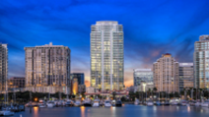
The EB-5 Immigrant Investor program allows qualified foreign nationals to obtain permanent U.S. residency (green cards) through an investment in a U.S. business venture or real estate development (Project).
By making an eligible EB-5 investment that creates at least 10 new U.S. jobs per investor, the investor and his/her spouse and children under 21 are eligible to receive permanent green cards and move to the U.S.
EB5AN is a government authorized EB-5 regional center (RC) operator, EB-5 consulting firm, and global investment fund manager.
EB5Investments.com
EB-5 Regional Center Investments
COMPANY OVERVIEW
CURRENT RC PROJECT INVESTMENT TERMS
SELECT COMPLETED PAST RC PROJECTS
Founding Year | 2013
Regional Center Sponsored EB-5 Funds | $1B+
Total Project Development Cost | $4.1B+
Total Sponsored EB-5 Investors | 2,000+
Total Sponsored EB-5 Investor Nationalities | 60+
Total Sponsored EB-5 Jobs Created to Date | 34,300+
Average Job Creation Ratio Above USCIS Requirement | 2.5x
Investment Amount | $800,000
Project Administrative Fee | Varies by Project
Annual Return | Varies by Project
Estimated immigration legal fees, USCIS filing fees and RC Integrity Fund fees | $20,000 - $35,000
Water Club North Palm Beach
USCIS I-526, I-924
Exemplar & I-829 Approved
Hyatt Boca Raton
INVESTMENT APPROACH
USCIS I-526 & I-924
Exemplar Approved
EB5AN’s approach is to identify institutional-quality real estate development projects that satisfy its strict internal underwriting criteria for both immigration and financial risk. EB5AN managed Projects are all fully capitalized and projected to create significantly more jobs per investor than are required under the EB-5 program.
EB5AN collaborates with The Kolter Group (Kolter), one of the largest private developers in the U.S. Kolter has successfully developed more than $19 billion in real estate since 1997 and has never failed to repay a loan or to repay an EB-5 investment.⁴
EB5AN is 100% independent from Kolter.
The Mark Sarasota
USCIS I-526 & I-924
Exemplar Approved
REGIONAL CENTER TRACK RECORD¹
I-924 and I-956 Initial Designation Approval Rate | 100%
I-924A and I-956G Annual Compliance / Current Standing | 100%
Westin Sarasota
PROJECT TRACK RECORD¹
EXECUTIVE TEAM
USCIS I-526 & I-924
Exemplar Approved
I-924 and I-956F Approval Rate | 100%
Project Completion/Development¹ | 100%
Managing Partners: Samuel B. Silverman and Michael B. Schoenfeld
The EB5AN executive team has extensive experience in business strategy, investment evaluation, and securities, tax, and immigration law. Before founding EB5AN, we advised Fortune 500 companies on growth and investment strategies and worked on some of the largest IPOs, securities offerings, and private equity buyouts. Graduates of Yale and UNC Chapel Hill, we previously worked at some of the most respected investment and professional services firms including the Boston Consulting Group (BCG), and AEA Investors.
INVESTOR TRACK RECORD¹
VUE Sarasota
I-526 and I-526E Approval Rate | 99.7%
Denials Based on Source of Funds | 0.3%
Repayment for I-526 or I-526E Denial² | 100%
I-829 Approval Rate | 100%
Funds in Good Standing or Repaid | 100%
USCIS I-526 & I-924
Exemplar Approved
Hyatt Fort Lauderdale
PROJECT INVESTMENT STRUCTURE¹
USCIS I-526 & I-924
Exemplar Approved
IMMIGRATION PROCESSING TIME¹ (months)
Limited partnership structure with a subscription price of $800,000 plus project administrative fee.
Repayment for loan or preferred equity-style RC investments takes place through a sale, refinancing, or cash flow from operations
Fixed loan term for RC loan-style projects
Expected USCIS Avg. for I-526E³ | 6 - 24 months
Past EB5AN Managed Project Avg. Processing Time | 18.9
Artistry Sarasota
USCIS I-924
Exemplar Approved
PROJECT CAPITAL STRUCTURE¹ | Avg. | PORTFOLIO OVERVIEW¹ | # | PROJECT LOCATION¹ | #
Developer Equity and Pre-sales | ≈27% | Total Projects (15 funds across 12 real estate developments) | 15 | Florida | 12
EB-5 Capital | ≈26% | Under Construction | 5 | Georgia | 2
Bank Loan | ≈47% | Construction Completed | 10 | Utah | 1
ONE St. Petersburg
USCIS I-526 & I-924
Exemplar Approved
1 Denotes EB5AN Managed Projects being select projects where EB5AN (i) has raised EB-5 capital, (ii) is serving as the fund manager for the EB-5 investment partnership, and (iii) is sponsoring the Project under an EB5AN RC.
2 As of September 1, 2021, EB5AN has had one investor unable to complete the source of funds process. This investor was immediately repaid under EB5AN’s I-526 approval refund guaranty.
3 Based on USCIS undertaking to implement reduced processing times by end of FY 2023, after which average processing time is expected to be 6 months. Subject to change and will vary based on rural or high unemployment TEA designation.
4 All Kolter Group EB-5 investments have either been closed and repaid in full or remain completely or partially outstanding and in compliance with all investment covenants.

